Slide 1
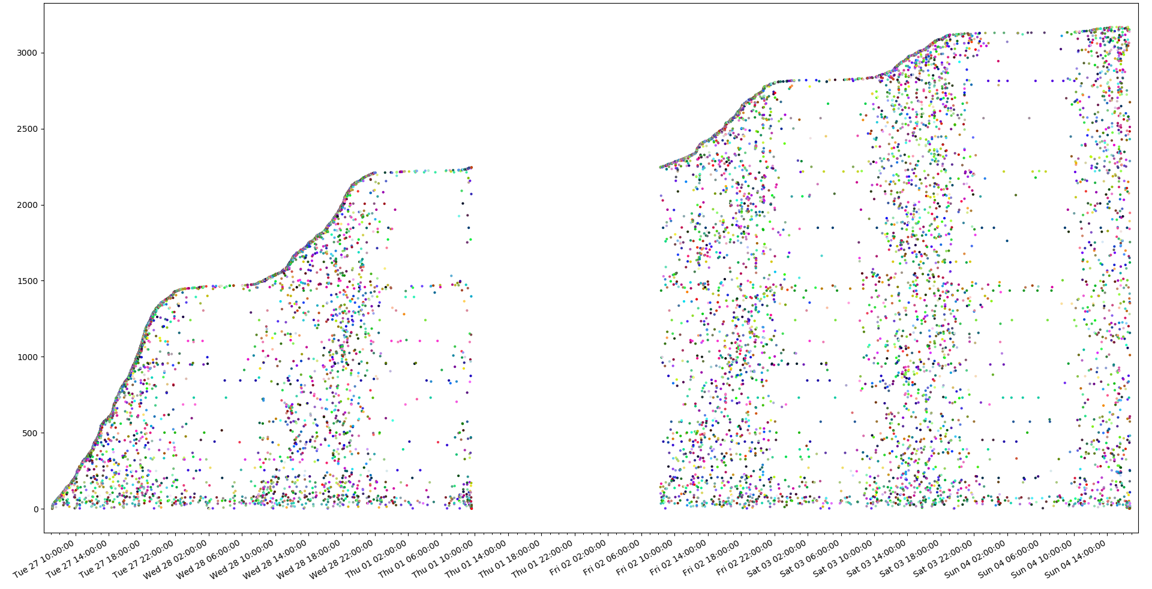
MAC activity tracker
N.Hokke
J. Brouwer

Slide 2
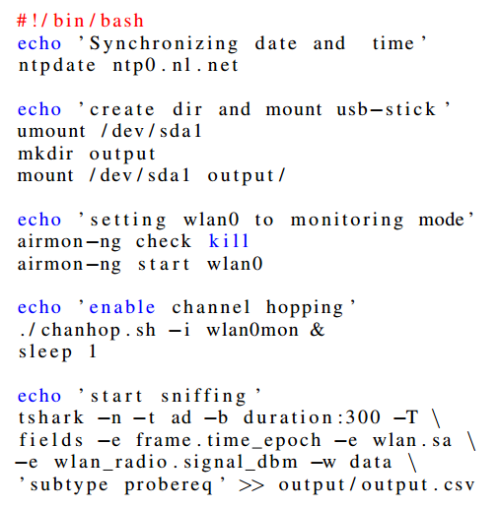
Method
Probe request
Hardware
Pi 3
Software
Kali Linux
Tshark
Python
Location?

Slide 3
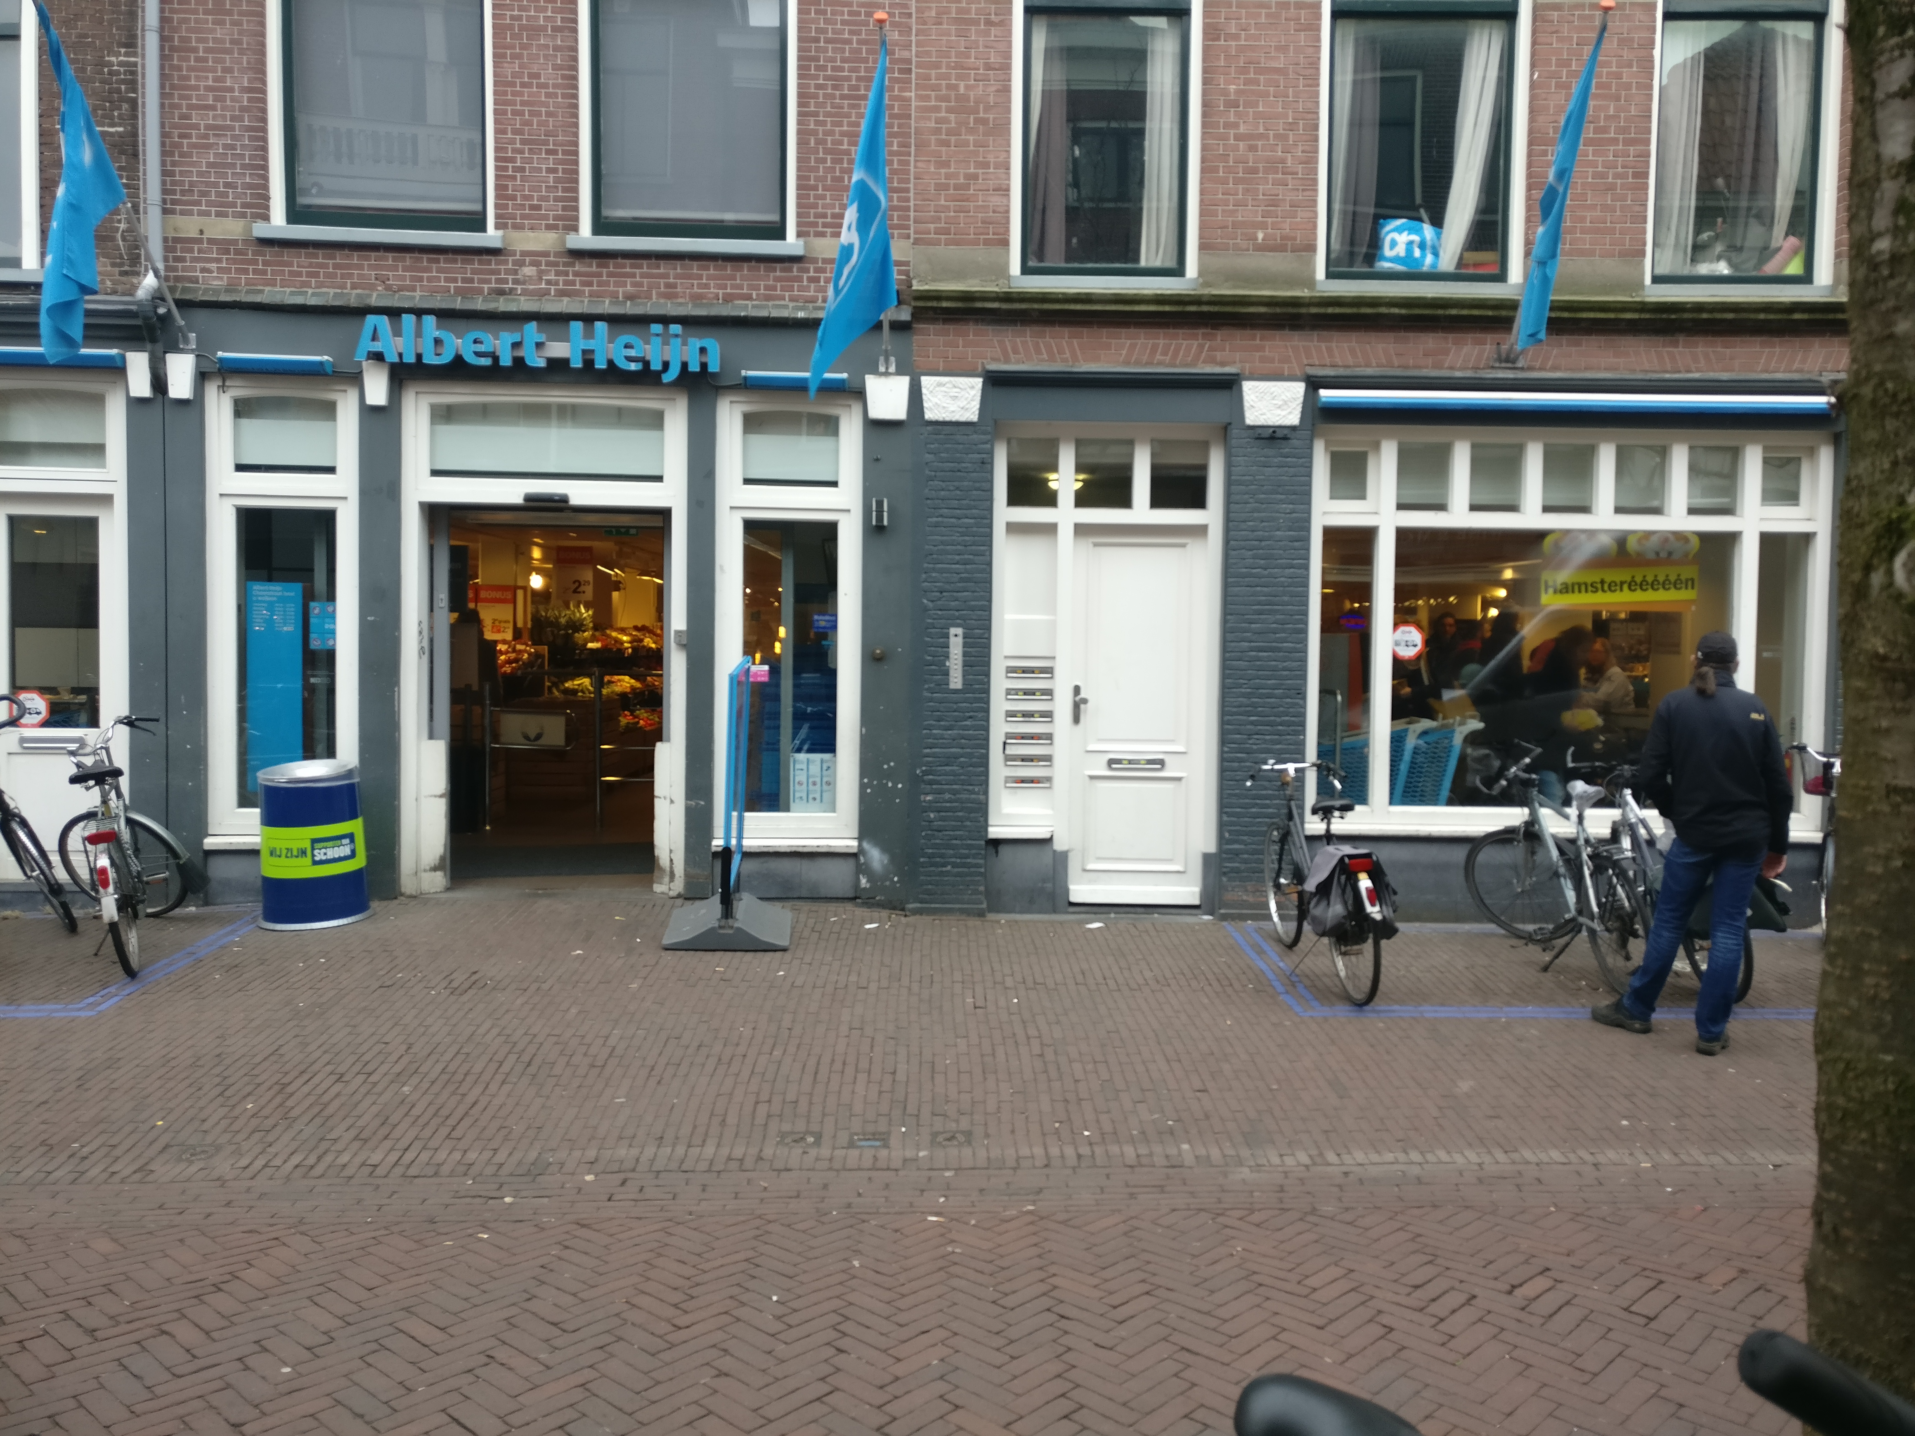
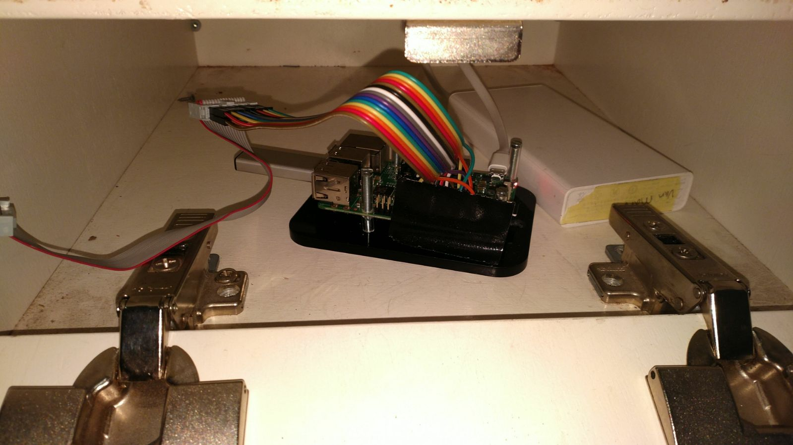
Notes:
Vraag voor mac uit publiek die hier waren afgelopen week!

Slide 4
Results
Preprocessing
1.182.393 probe requests
91.626 unique mac addresses
Python
Delete singletons
Filter based on interval or MAC
Visualization
MAC occurrences over time
Number of unique MAC over time
Market share by vendor ID

Slide 5
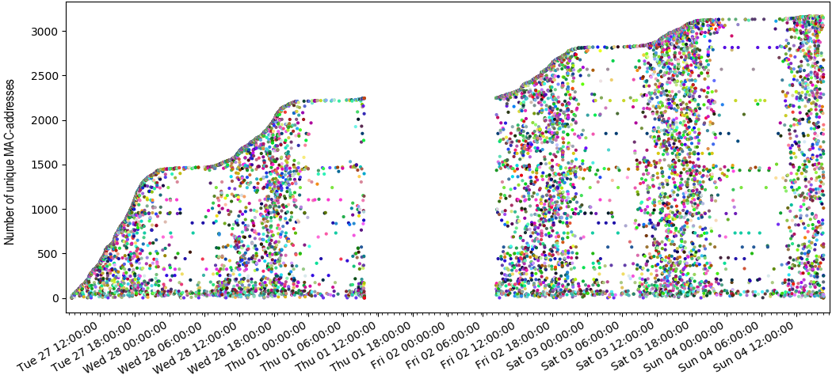
MAC occurrences over time

Slide 6
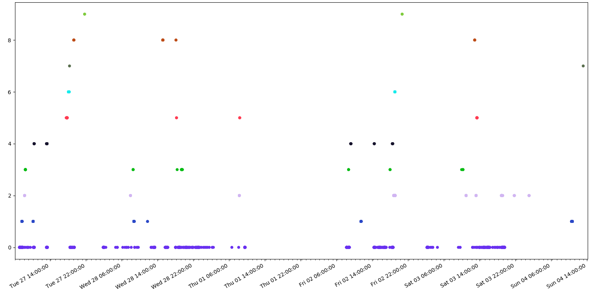
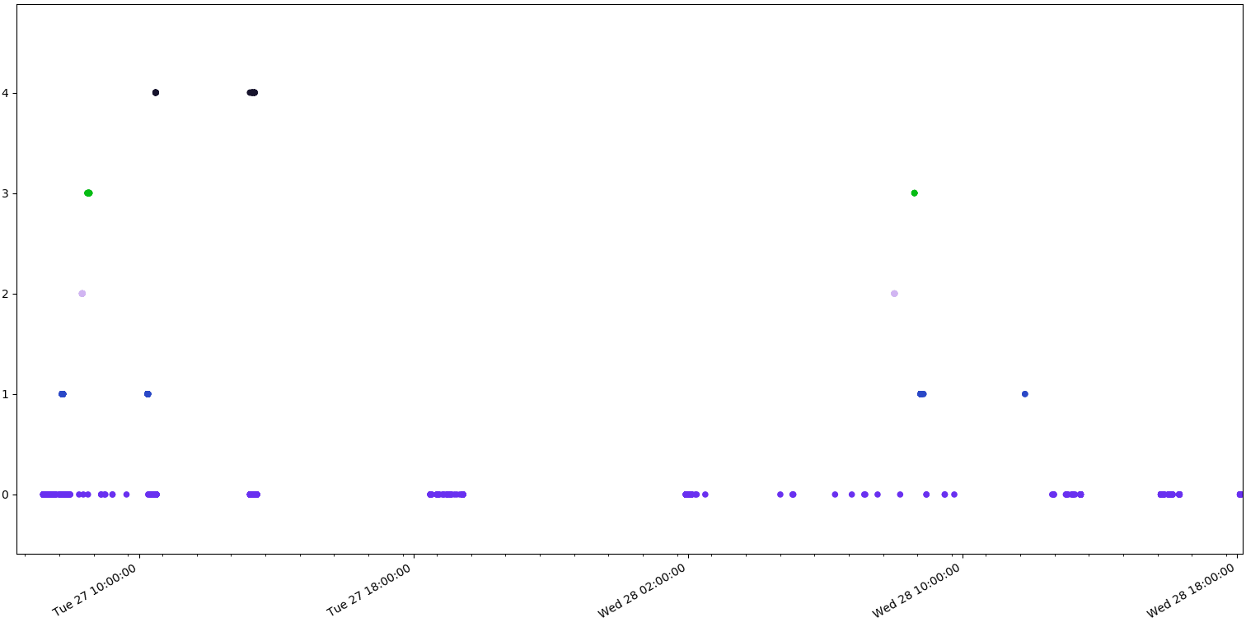
MAC occurrences over time

Slide 7
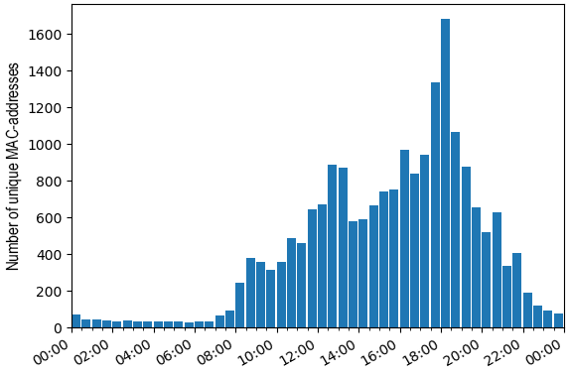
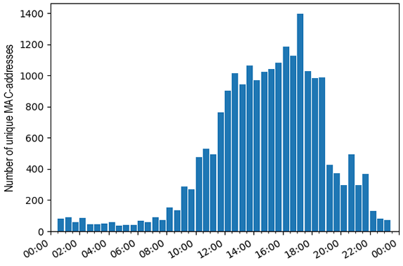

Slide 8
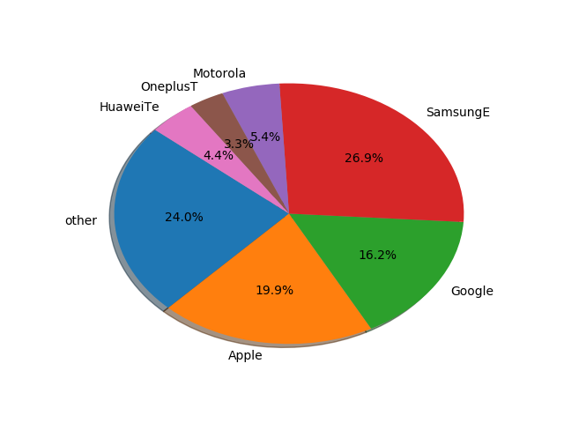
Results

Slide 9
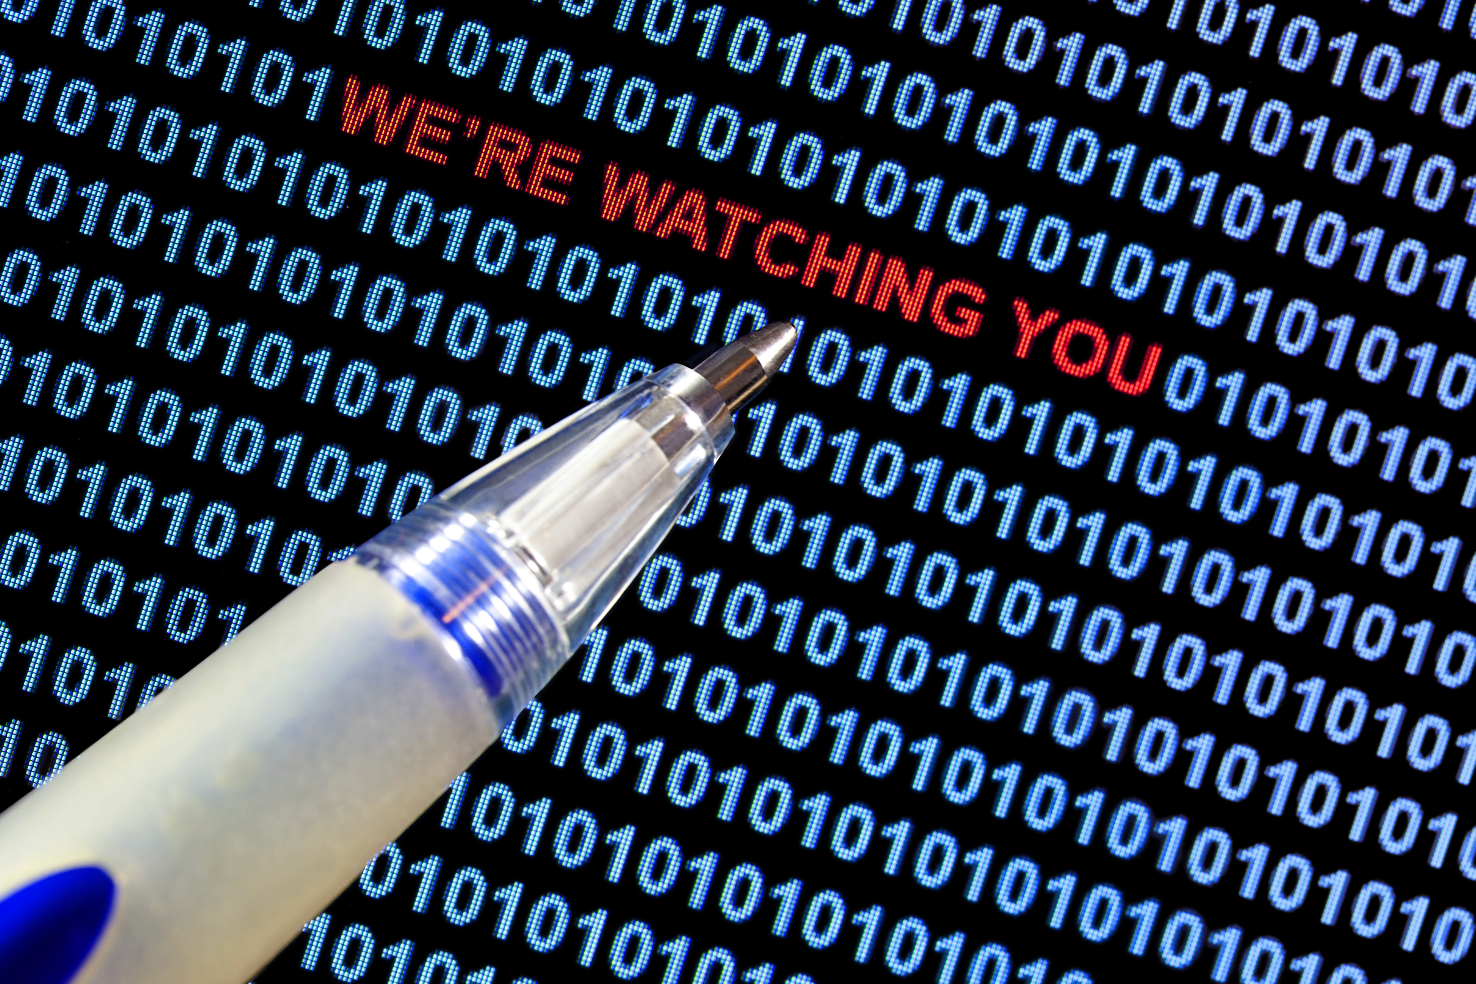
QUESTIONS?

Slide 10
https://github.com/NielsHokke/MAC_Tracker

